Slide 1

Utilizing Large Language Models (LLMs) for Enhanced Cell Type Annotation: A User-Centric Approach
Anwita Molaka
Notes:
Thank you so much for this opportunity, I am very excited to be here. My name is Anwita Molaka, and today, I’m going to be talking about utilizing large language models for enhanced cell type annotation, taking a user-centric approach.

Slide 2
Introduction
Single-cell RNA sequencing (scRNA-seq) is a risingly popular and powerful tool used for transcriptomic analysis. This technique has significantly advanced our understanding of the genetic variations between individuals and among different cells within each tissue.
Despite recent advancements, many analytical tasks remain challenging or unexplored, particularly for tissue and cell types lacking consistent key marker databases. Large language models (LLMs) have been a recent topic of exploration to enhance various genetic and bioinformatic processes.
This project explores the use of LLMs like OpenAI’s ChatGPT and Meta’s Llama3 to improve the accuracy and accessibility of cell-type annotation. The overall goal of this project was to enhance cell-type annotations and push further analyses using LLMs, while developing an interactive platform for users with varying levels of expertise to bridge the gap between biology, technology, and artificial intelligence.
Notes:
As I’m sure many of you all in this room are already familiar…
Whether you’re an expert in bioinformatics or have never touched it before, we wanted this to be…
Interactive platform is Shiny app

Slide 3
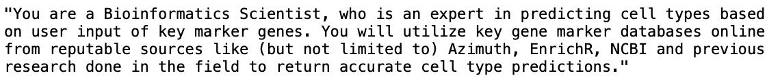
Training
Pre-training: System Role Formulation
Specified reputable databases, key markers, and focused task
Notes:
The first step of this project was pre-training, and we had three different components involved. The first was system role formulation, which involved three specific components. We specified reputable databases for the LLM to reference when analyzing data, emphasized the use of key markers for analysis, and described the focused task –- cell type annotation.

Slide 4
Training
Prompt Engineering
Phase 1 – yielded long responses and unnecessary information from LLM
Notes:
The next part of our training was prompt engineering, which was actually one of the most interesting parts of our research. We had 4 different phases of prompts. The first was very straightforward…..<read prompt>. And the result was….

Slide 5
Prompt Engineering – Phase 1 Example Output
"To predict the cell type based on the provided marker genes, I'll refer to databases and research papers for information about these genes. Here's a breakdown of what some of these marker genes are known to indicate:\n\n1. **S100A12**: Often associated with myeloid cells, especially neutrophils and some macrophages.\n2. **S100A8**: Frequently expressed in myeloid cells, particularly in neutrophils and inflammatory macrophages.\n3. **CYP1B1**: Involved in many cellular processes; seen in various tissue types, but commonly in cells dealing with detoxification like liver cells, but also expressed in monocytes/macrophages.\n4. **PADI4 and PADI2**: Typically associated with myeloid cells, particularly involved in the formation of neutrophil extracellular traps (NETs).\n5. **MGST1**: Glutathione S-transferase, often expressed broadly but can be upregulated in myeloid cells.\n6. **CRISPLD2**: Known for having roles in immune responses and is often seen in myeloid cells and macrophages.\n7. **CES1**: Carboxyl ester lipase, known to be highly expressed in liver and monocytes/macrophages.\n8. **QPCT**: Likely broadly expressed, but certain isoforms have associations with monocytes/macrophages.\n9. **MARC1**: Associated with mitochondrial myopathies and frequently seen in liver cells, but isoforms are known in macrophage function.\n10. **MCEMP1**: Marker for myeloid cell lineage, especially involved in immune cell differentiation.\n11. **WLS**: Wnt ligand secretion mediator, broadly expressed but notable roles in immune cells.\n12. **SEMA3C**: Involved in axonal guidance; its expression in the immune context, specifically myeloid lineage.\n13. **VNN3 and VNN1**: Vanin genes, involved in inflammation, highly expressed in macrophages.\n14. **SPOCK1**: Known for broader roles in cellular structure but implicated in immunological cells, including myeloid types.\n15. **RETN (Resistin)**: Chiefly expressed in myeloid cells, particularly macrophages.\n16. **TDRD9**: Generally associated with germ cell development; less known in myeloid cells.\n17. **CLTCL1**: Associated with entrapping clathrin; broad expression including immune cells.\n\nGiven the predominant expression of these genes in myeloid cell types, particularly macrophages (e.g., S100A12, S100A8, PADI4, RETN, VNN1, VNN3):\n\n**Predicted cell type: Inflammatory Macrophage/Monocyte.**\n\nA large proportion of these markers are heavily tied to immune functions, and specifically, many (like S100A8, S100A12, and RETN) are strongly linked to inflammatory responses typically seen in macrophages and monocytes."
Notes:
And this was our result. This prompt yielded very long responses from the LLM , with the predicted cell type, the key genes behind this prediction, and their roles. While this information is very useful for learning more about why the model is returning a particular cell type, we wanted to display only the cell type to the user for easy interpretation.

Slide 6
Training
Prompt Engineering
Phase 2 – yielded shorter responses, but still unnecessary information
Notes:
So for the next phase, we added just the word “only” to our prompt

Slide 7

Prompt Engineering – Phase 2 Example Output
Cluster 0: The provided key marker genes suggest that the cluster corresponds to **Neutrophils**.,
Cluster 1: The provided key marker genes suggest a profile of T cells, specifically T follicular helper cells (Tfh). Key markers like CD40LG, ICOS, GATA3, and SLAMF1 are heavily associated with Tfh cells.,
Notes:
The result was much more condensed, but the model still returned some extra information about the key marker genes behind the prediction.

Slide 8
Training
Prompt Engineering
Phase 3 – yielded ideal responses
Notes:
For the third phase, we added the phrase “no other words” to further emphasize our need for a simple response from the model

Slide 9
Prompt Engineering – Phase 3 Example Output
Cluster 0: Monocyte
Cluster 1: T cells
Cluster 2: Monocyte
Cluster 3: T cells
Cluster 4: CD8+ T cells
Cluster 5: Dendritic cells
Cluster 6: Plasmacytoid dendritic cells
Cluster 7: Plasma cells
Cluster 8: Naive B cells
Cluster 9: T cells
Cluster 10: NK cells
Cluster 11: CD8+ T Cell
Cluster 12: NK cells
Cluster 13: Monocytes
Cluster 14: CD8+ T cells
Cluster 15: Dendritic cells
Cluster 16: Neutrophils
Cluster 17: CD8+ Gamma Delta T cells Cluster 18: T regulatory cell
Cluster 19: Plasmacytoid Dendritic Cells (pDCs)
Cluster 20: B cells
Cluster 21: Platelets
Cluster 22: Natural Killer Cell
Notes:
This result was in the format we wanted, with just the predicted cell types being returned. However, many of these cell types were surface-level parent names, rather than more specific cell types. Thus, we knew we could push the model further.

Slide 10
Training
Prompt Engineering
Phase 4 – yielded ideal, more in-depth responses
Notes:
We added a short sentence with context about the dataset we were working with, so that the model had a better foundation to return cell type predictions.

Slide 11
Prompt Engineering – Phase 4 Example Output
Cluster 0: Monocyte
Cluster 1: Th2 cells
Cluster 2: Classical Monocytes Cluster 3: T cells
Cluster 4: CD8+ T cells
Cluster 5: Dendritic Cells
Cluster 6: Monocytes
Cluster 7: Plasmablasts
Cluster 8: Naive B cells
Cluster 9: T cells
Cluster 10: NK cells
Cluster 11: CD8+ T cells
Cluster 12: NK cells
Cluster 13: Natural Killer cells
Cluster 14: CD8+ T cells
Cluster 15: DC10
Cluster 16: Monocyte
Cluster 17: MAIT cells
Cluster 18: Regulatory T cells (Tregs)
Cluster 19: pDC (plasmacytoid dendritic cell)
Cluster 20: B cells
Cluster 21: Platelets
Cluster 22: NK cells
Notes:
Though some of these cell types were the same, the addition of the context sentence resulted in more specific, daughter cell types. Rather than monocyte, for cluster 2 for example, we get classical monocytes. Higher degree of specificity of cell types, while maintaining overall group

Slide 12

Training
Datasets of Interest:
10k Human PBMCs, 3' v3.1, Chromium X (with intronic reads)
7.5k Sorted Cells from Human Invasive Ductal Carcinoma, 3’ v3.1
Notes:
PBMCs for known markers – many key marker databases available
IDC for unknown markers – little to no key marker databases or consistent information available

Slide 13
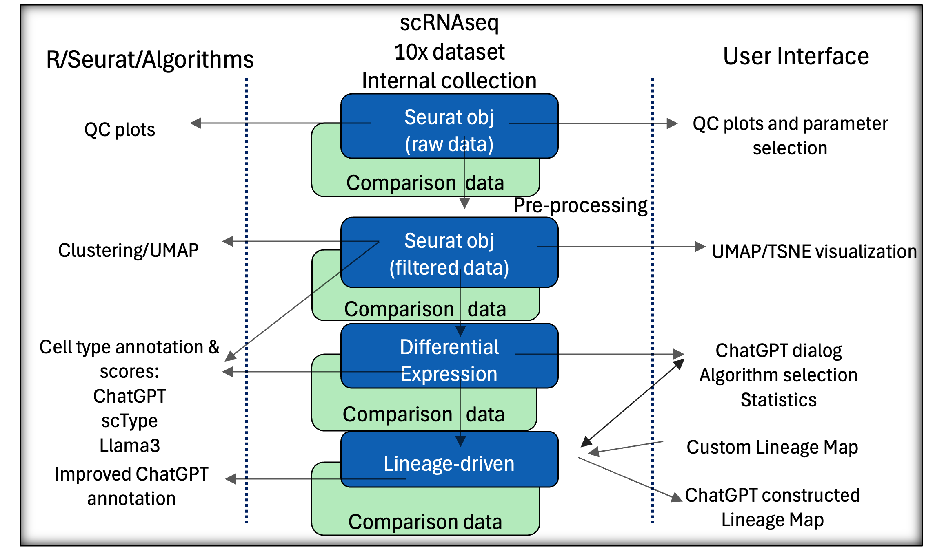
Workflow
Notes:
User interface and R/Seurat algorithms in the back-end for Shiny app
Give option for QC plot parameter selection
Preprocess data and give clustering, umap, tsne
Then we do differential expression and do our standard and LLM-based cell type annotation → user can input prompt about dataset to interact, choose between gpt-4o, gpt-3.5-turbo, llama3
Accuracy scores
Lineage maps

Slide 14
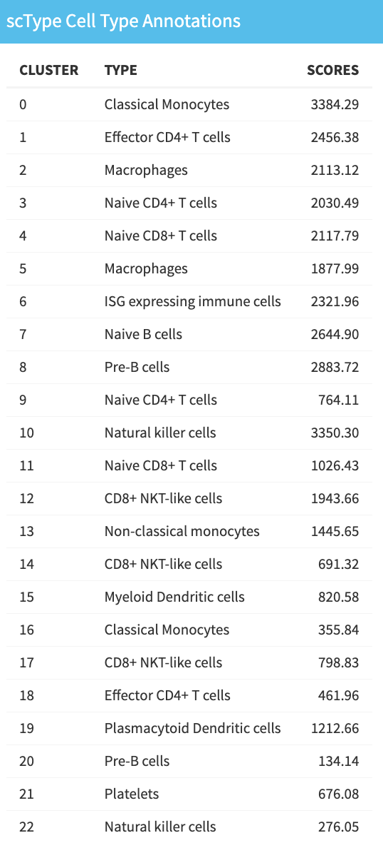
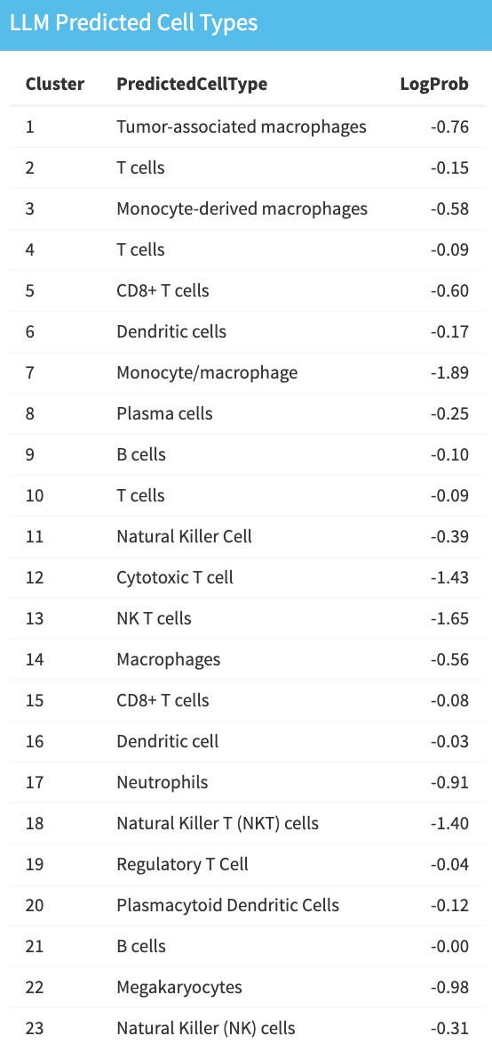
Results – PBMC
Unpublished
Notes:
LLM-predicted cell types are very similar to that of scType
- scType is typically more specific, as PBMC is a popular dataset and scType has many known gene markers for this data
Scores for scType are high → high confidence
Logprob for LLM is close to 0 → high confidence
Select tissue type immune cell for scType

Slide 15
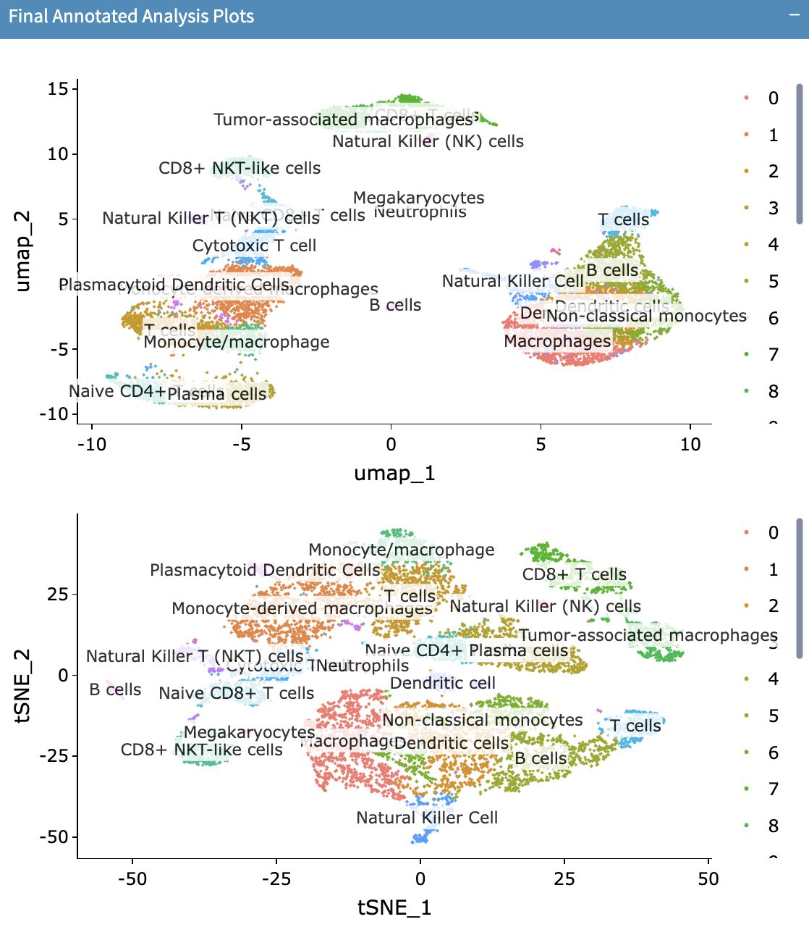
Results – PBMC
Unpublished
Notes:
Compared scType scores and LLM logprobs, took highest as the annotation for the final analysis UMAP

Slide 16
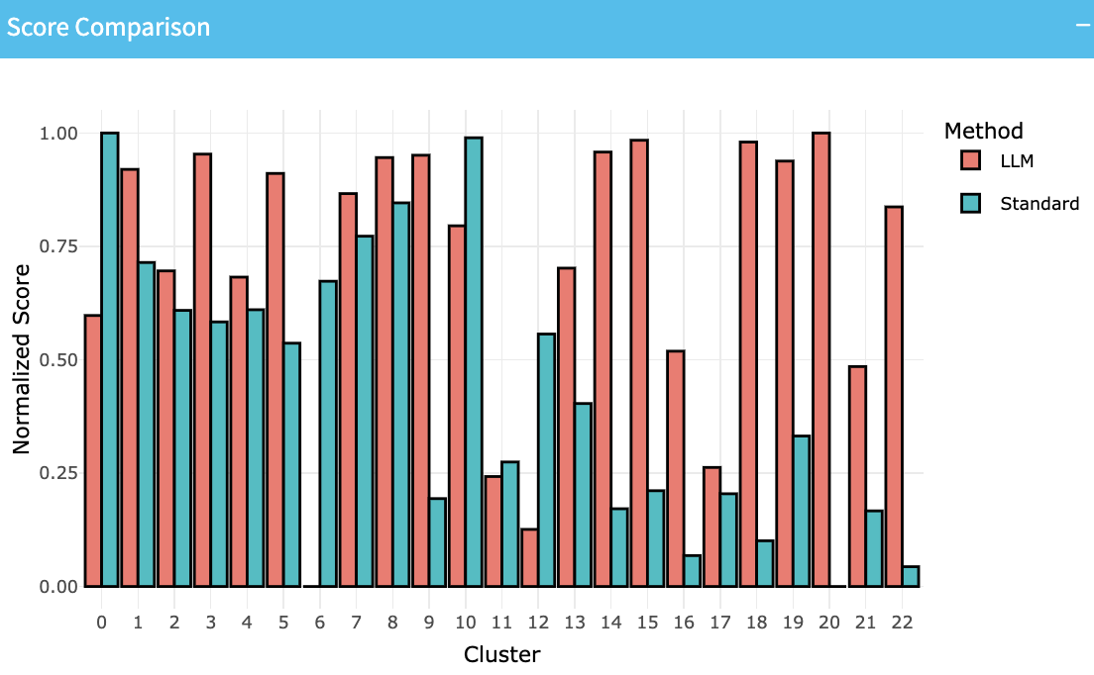
Results – PBMC
Unpublished
Notes:
Different scales →
Normalize scores using Caret’s preprocess method → The preProcess() function enables us to scale the value to a range of 0 to 1 using method = c('range')as an argument. With Min-Max Scaling, we scale the data values between a range of 0 to 1 only. Due to this, the effect of outliers on the data values suppresses to a certain extent. Moreover, it helps us have a smaller value of the standard deviation of the data scale.
We actually see that overall, the LLM had a higher score than the standard method across the clusters. However, these normalized scores are generally pretty similar in values.

Slide 17
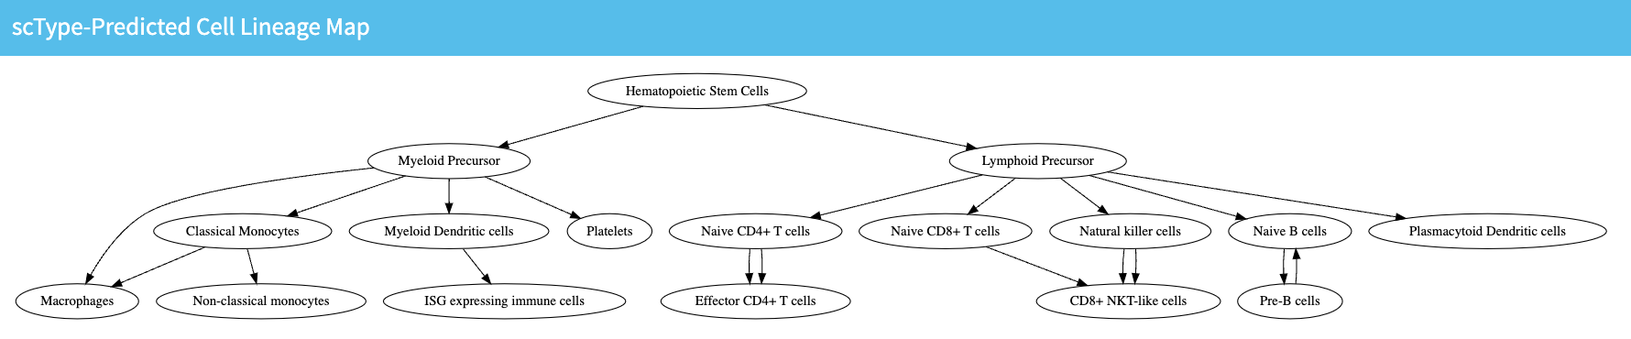
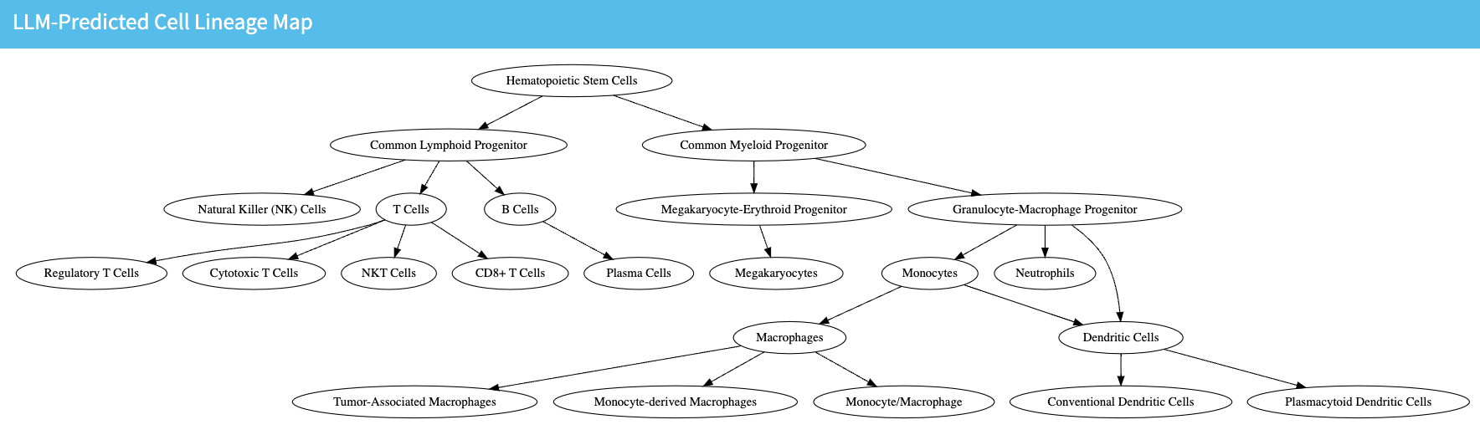
Results – PBMC
Unpublished
Notes:
We wanted to push the model further and see if we can higher-level analyses of the relationships between the cell types. We used the LLM to generate a lineage map using the scType predictions, and another using the LLM predictions. Both show similar relationships between cell types and are very detailed.

Slide 18
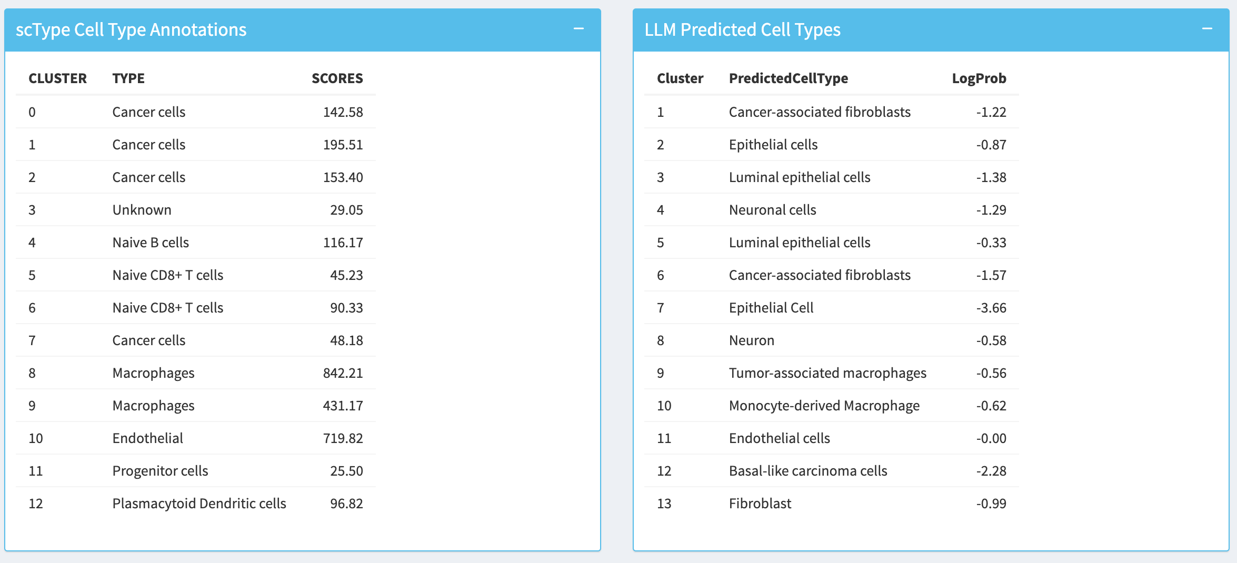
Results – Invasive Ductal Carcinoma
Unpublished
Notes:
Most interesting results were for IDC
scType requires that we pick tissue type → breast is not defined, so we actually left it as immune cells to see what would happen
scType, interestingly, was able to detect that we were working with cancer cells (also has immune cells, which are present in cancer cells)
- however, it is not specific at all, and sometimes could not even determine the cell type (unknown)
- scores for scType were also very low → low confidence
LLM was able to give more in-depth cell type predictions → different types of cancer cells, epithelial cells, immune cells, etc
- log probabilities mostly close to 0 → pretty high confidence
scType and LLM predictions differed more from each other

Slide 19
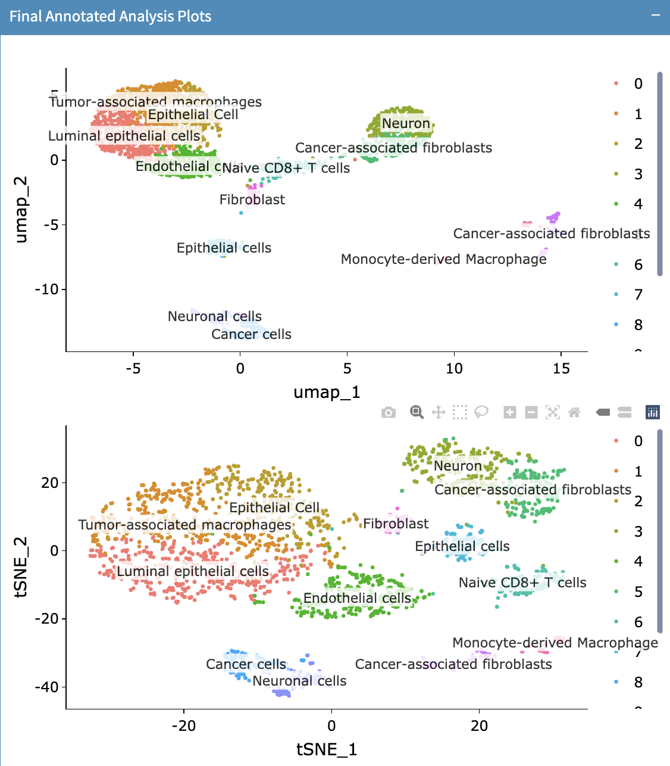
Results – Invasive Ductal Carcinoma
Unpublished
Notes:
Again, did the same thing where we assigned the prediction with the highest confidence/accuracy score to the final UMAP clusters

Slide 20
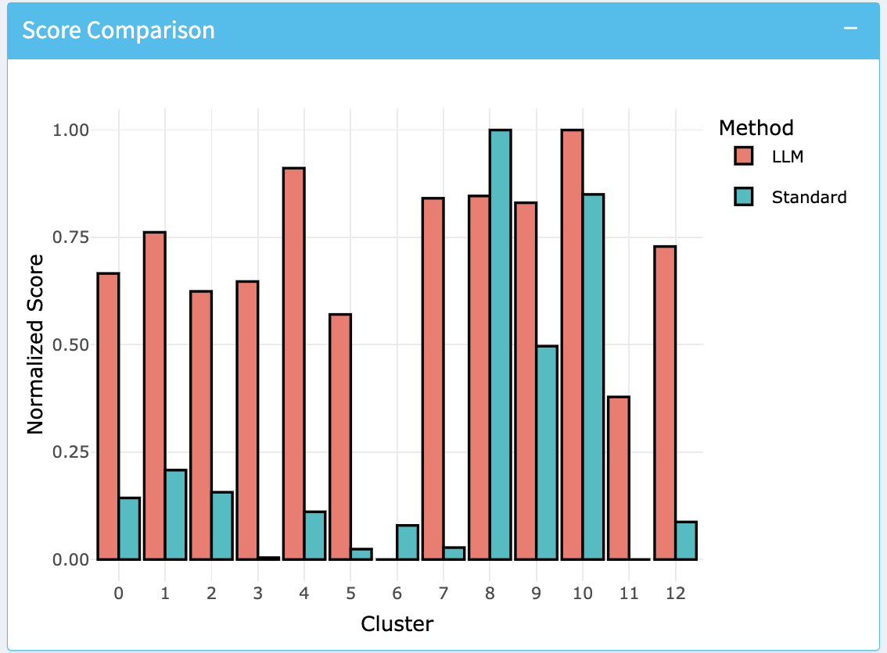
Results – Invasive Ductal Carcinoma
Unpublished
Notes:
Same thing with normalization
We see the same general pattern of LLM having higher overall normalized scores across the different questions.
However, there is a much greater difference in the scores here, suggesting that the LLM can actually be more helpful in cases where we do not have standard key markers available, which is necessary for the standard methods to perform well.

Slide 21
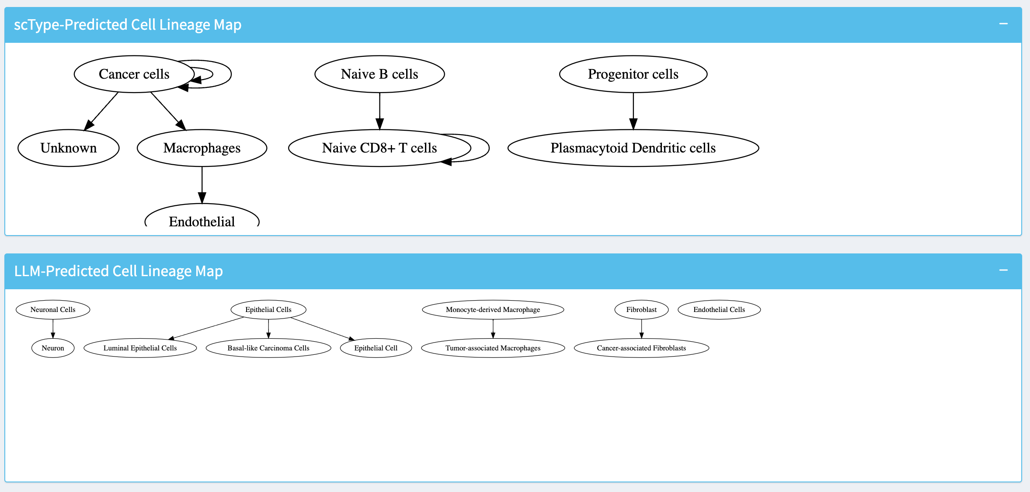
Results – Invasive Ductal Carcinoma
Unpublished
Notes:
Again, we generated lineage maps based on the standard cell type predictions and LLM cell type predictions.
Here, we see that for the standard map, we have very basic cell types and a relatively surface-level cell lineage map.
LLM-predicted cell types are a little more specific, with the lineage map being a little more in depth as well.

Slide 22
Conclusion
LLM-assisted cell type annotation is accurate and comparable to conventional methods like scType
GPT-4o yielded the most accurate, in-depth results, followed by GPT-3.5-turbo
Llama3, while less complex for both datasets, provides a comparable and free alternative
LLM-assisted cell type annotation had overall higher normalized prediction scores
LLM-assisted cell type annotation is particularly valuable for datasets without marker databases
Ongoing work is being done to further the depth of analyses, particularly regarding lineage-driven work
Notes:
Future work –
Work more on lineage maps and see if we can feed back to the model to further improve upon and enhance cell type annotaitons
Test different standard methods
Find a way to standardize key marker databases

Slide 23


Acknowledgements
Chen Lab
Yavuz Inan (summer intern, 2024)
Dr. Tapsya Nayak
Dr. Hanzhou Wang
Dr. Nam Nhut Phan
Dr. Yidong Chen
Greehey CCRI Donald G McEwen Memorial Summer Research Program
Funding Sources
Cancer Prevention and Research Institute of Texas (CPRIT) RP220662
NIH-NCI P30 CA054174 (Cancer Center at UT Health San Antonio)
Notes:
I would like to thank Dr. Chen and Chen lab for their support, as well as our funding sources .

